Slide 1
Evaluating Model Performance

Slide 2
Evaluating Model Performance
The process of evaluating machine learning algorithms is needed since algorithms
have varying strengths and weaknesses,
tests should distinguish among the learners.
to forecast how a learner will perform on future data.

Slide 3
Measuring performance for classification
We measured classifier accuracy by dividing the proportion of correct predictions by the total number of predictions.
This indicates the percentage of cases in which the learner is right or wrong.
Though there are many ways to measure a classifier's performance, the best measure is always the one that captures whether the classifier is successful at its intended purpose.

Slide 4
Confusion matrix
A confusion matrix is a table that categorizes predictions according to whether they match the actual value.
One of the table's dimensions indicates the possible categories of predicted values, while the other dimension indicates the same for actual values.
Although we have only seen 2 x 2 confusion matrices so far, a matrix can be created for models that predict any number of class values.

Slide 5
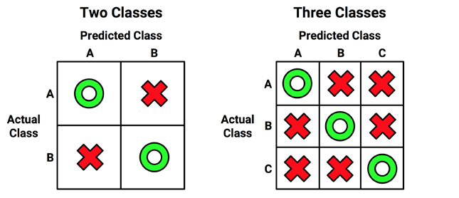
Confusion matrix
The figure depicts the familiar confusion matrix for a two-class binary model as well as the 3 x 3 confusion matrix for a three-class model.

Slide 6
Confusion matrix
When the predicted value is the same as the actual value, it is a correct classification.
Correct predictions fall on the diagonal in the confusion matrix (denoted by O).
The off-diagonal matrix cells (denoted by X) indicate the cases where the predicted value differs from the actual value.
These are incorrect predictions.
The performance measures for classification models are based on the counts of predictions falling on and off the diagonal in these tables

Slide 7
Confusion matrix
The most common performance measures consider the model's ability to discern one class versus all others.
The class of interest is known as the positive class, while all others are known as negative.

Slide 8
Confusion matrix
The relationship between the positive class and negative class predictions can be depicted as a 2 x 2 confusion matrix that tabulates whether predictions fall into one of the four categories:
True Positive (TP): Correctly classified as the class of interest
True Negative (TN): Correctly classified as not the class of interest
False Positive (FP): Incorrectly classified as the class of interest
False Negative (FN): Incorrectly classified as not the class of interest

Slide 9
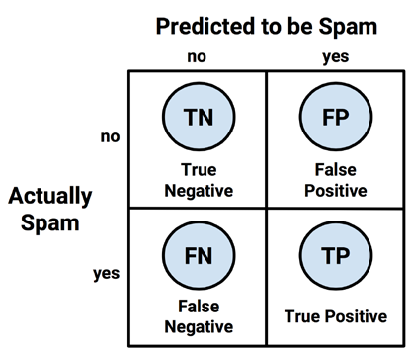
Confusion matrix
For the spam classifier, the positive class is spam, as this is the outcome we hope to detect. We can then imagine the confusion matrix as in the diagram:

Slide 10

Using confusion matrices to measure performance
With the 2 x 2 confusion matrix, we can formalize our definition of prediction accuracy (sometimes called the success rate) as:
the terms TP, TN, FP, and FN refer to the number of times the model's predictions fell into each of these categories.
The accuracy is therefore a proportion that represents the number of true positives and true negatives, divided by the total number of predictions.

Slide 11
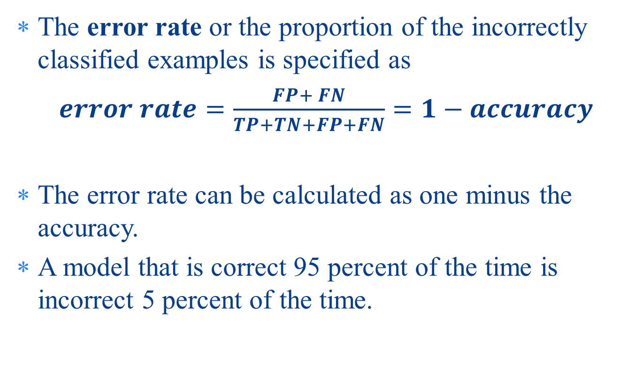
Using confusion matrices to measure performance
The error rate or the proportion of the incorrectly classified examples is specified as
$error rate=\frac{FP+ FN}{TP+TN+FP+FN}=1−accuracy$
The error rate can be calculated as one minus the accuracy.
A model that is correct 95 percent of the time is incorrect 5 percent of the time.

Slide 12
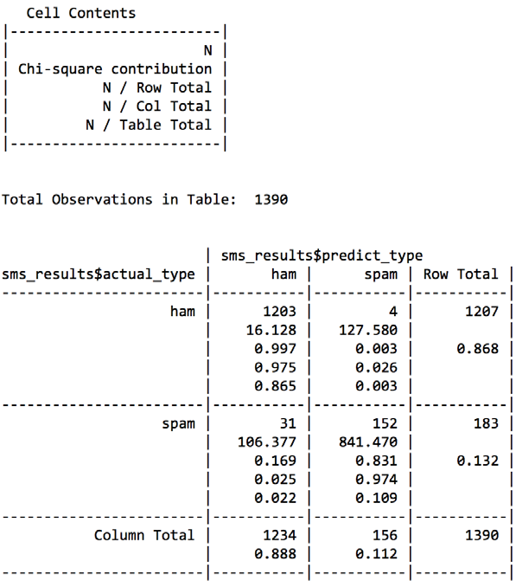

Slide 13
Beyond accuracy – other measures of performance
Countless performance measures have been developed and used for specific purposes in disciplines as diverse as medicine, information retrieval, marketing, and signal detection theory, among others.
We'll consider only some of the most useful and commonly cited measures in the machine learning literature.

Slide 14
The kappa statistic
The kappa statistic adjusts accuracy by accounting for the possibility of a correct prediction by chance alone.
This is especially important for datasets with a severe class imbalance, because a classifier can obtain high accuracy simply by always guessing the most frequent class.
The kappa statistic will only reward the classifier if it is correct more often than this simplistic strategy.

Slide 15
The kappa statistic
Kappa values range from 0 to a maximum of 1, which indicates perfect agreement between the model's predictions and the true values.
Values less than one indicate imperfect agreement.
Depending on how a model is to be used, the interpretation of the kappa statistic might vary.

Slide 16
The kappa statistic
One common interpretation is shown as follows:
Poor agreement = less than 0.20
Fair agreement = 0.20 to 0.40
Moderate agreement = 0.40 to 0.60
Good agreement = 0.60 to 0.80
Very good agreement = 0.80 to 1.00
It's important to note that these categories are subjective. While a "good agreement“ may be more than adequate to predict someone's favorite ice cream flavor, "very good agreement" may not suffice if your goal is to identify birth defects.

Slide 17

The kappa statistic
The formula to calculate the kappa statistic.
In this formula, Pr(a) refers to the proportion of the actual agreement and Pr(e) refers to the expected agreement between the classifier and the true values, under the assumption that they were chosen at random:

Slide 18
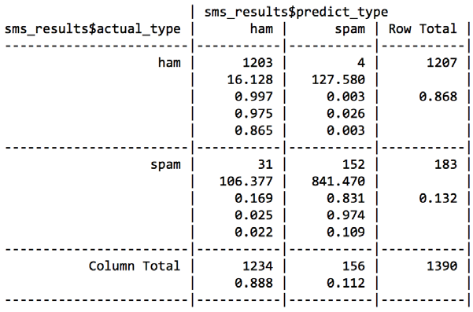
The kappa statistic
The bottom value in each cell indicates the proportion of all instances falling into that cell.
Therefore, to calculate the observed agreement Pr(a), we simply add the proportion of all instances where the predicted type and actual SMS type agree.
Thus, we can calculate Pr(a) as:
> pr_a <- 0.865 + 0.109
> pr_a
[1] 0.974

Slide 19
The kappa statistic
The observed and actual values agree 97.4 percent of the time—you will note that this is the same as the accuracy.
The kappa statistic adjusts the accuracy relative to the expected agreement Pr(e), which is the probability that the chance alone would lead the predicted and actual values to match, under theassumption that both are selected randomly according to the observed proportions.
Assuming two events are independent (meaning that one does not affect the other), probability rules note that the probability of both occurring is equal to the product of the probabilities of each one occurring.
The probability of both choosing ham is:
Pr(actual type is ham) * Pr(predicted type is ham)

Slide 20
The kappa statistic
The probability of both choosing spam is:
Pr(actual type is spam) * Pr(predicted type is spam)
The probability that the predicted or actual type is spam or ham can be obtained from the row or column totals.
Pr(actual type is ham) = 0.868 and Pr(predicted type is ham) = 0.888.
Pr(e) is calculated as the sum of the probabilities that by chance the predicted and actual values agree that the message is either spam or ham.
For mutually exclusive events (events that cannot happen simultaneously), the probability of either occurring is equal to the sum of their probabilities.
Therefore, to obtain the final Pr(e), we simply add both products
> pr_e <- 0.868 * 0.888 + 0.132 * 0.112
> pr_e
[1] 0.785568

Slide 21
The kappa statistic
Since Pr(e) is 0.786, by chance alone, we would expect the observed and actual values to agree about 78.6 percent of the time.
This means that we now have all the information needed to complete the kappa formula.
Plugging the Pr(a) and Pr(e) values into the kappa formula, we find:
> k <- (pr_a - pr_e) / (1 - pr_e)
> k
[1] 0.8787494
The kappa is about 0.88, which agrees with the previous confusion Matrix()

Slide 22
Sensitivity and specificity
Finding a useful classifier often involves a balance between predictions that are overly conservative and overly aggressive.
For example, an e-mail filter could guarantee to eliminate every spam message by aggressively eliminating nearly every ham message at the same time.
On the other hand, guaranteeing that no ham message is inadvertently filtered might require us to allow an unacceptable amount of spam to pass through the filter.
A pair of performance measures captures this tradeoff: sensitivity and specificity.

Slide 23

Sensitivity and specificity
The sensitivity of a model (also called the true positive rate) measures the proportion of positive examples that were correctly classified.
It is calculated as the number of true positives divided by the total number of positives, both correctly classified (the true positives) as well as incorrectly classified (the false negatives):

Slide 24

Sensitivity and specificity
The specificity of a model (also called the true negative rate) measures the proportion of negative examples that were correctly classified.
As with sensitivity, this is computed as the number of true negatives, divided by the total number of negatives—the true negatives plus the false positives:

Slide 25
Sensitivity and specificity
Given the confusion matrix for the SMS classifier, we can easily calculate these measures by hand.
Assuming that spam is the positive class, we can confirm that the numbers in the confusionMatrix() output are correct.

Slide 26
Sensitivity and specificity
The calculation for sensitivity is:
> sens <- 152 / (152 + 31)
> sens
[1] 0.8306011
Similarly, for specificity we can calculate:
> spec <- 1203 / (1203 + 4)
> spec
[1] 0.996686

Slide 27
Sensitivity and specificity
Sensitivity and specificity range from 0 to 1, with values close to 1 being more desirable.
For example, in this case, the sensitivity of 0.831 implies that 83.1 percent of the spam messages were correctly classified.
Similarly, the specificity of 0.997 implies that 99.7 percent of the nonspam messages were correctly classified or, alternatively, 0.3 percent of the valid messages were rejected as spam.

Slide 28
Sensitivity and specificity
The idea of rejecting 0.3 percent of valid SMS messages may be unacceptable, or it may be a reasonable trade-off given the reduction in spam.
Sensitivity and specificity provide tools for thinking about such trade-offs.
Typically, changes are made to the model and different models are tested until you find one that meets a desired sensitivity and specificity threshold.

Slide 29
Precision and recall
Used primarily in the context of information retrieval, these statistics are intended to provide an indication of how interesting and relevant a model's results are, or whether the predictions are diluted by meaningless noise.
The precision (also known as the positive predictive value) is defined as the proportion of positive examples that are truly positive; in other words, when a model predicts the positive class, how often is it correct?
A precise model will only predict the positive class in cases that are very likely to be positive. It will be very trustworthy.

Slide 30

Precision and recall
What would happen if the model was very imprecise.
Over time, the results would be less likely to be trusted.
In the case of the SMS spam filter, high precision means that the model is able to carefully target only the spam while ignoring the ham.

Slide 31

Precision and recall
Recall is a measure of how complete the results are.
This is defined as the number of true positives over the total number of positives.
You may have already recognized this as the same as sensitivity.
In this case, the interpretation differs slightly.

Slide 32
Precision and recall
A model with a high recall captures a large portion of the positive examples, meaning that it has wide breadth.
For example, a search engine with a high recall returns a large number of documents pertinent to the search query.
Similarly, the SMS spam filter has a high recall if the majority of spam messages are correctly identified.

Slide 33
Precision and recall
We can calculate precision and recall from the confusion matrix.
Assuming that spam is the positive class, the precision is:
> prec <- 152 / (152 + 4)
> prec
[1] 0.974359
The recall is:
> rec <- 152 / (152 + 31)
> rec
[1] 0.8306011

Slide 34
Precision and recall
It is difficult to build a model with both high precision and high recall.
In contrast, having both high precision and recall at the same time is very challenging.
It is therefore important to test a variety of models in order to find the combination of precision and recall that will meet the needs of your project.

Slide 35
Precision and recall The F-measure
A measure of model performance that combines precision and recall into a single number is known as the F-measure (also sometimes called the F1 score or F-score).
The F-measure combines precision and recall using the harmonic mean, a type of average that is used for rates of change.
The harmonic mean is used rather than the common arithmetic mean since both precision and recall are expressed as proportions between zero and one, which can be interpreted as rates.

Slide 36
Precision and recall The F-measure
To calculate the F-measure, use the precision and recall values computed previously:
> f <- (2 * prec * rec) / (prec + rec)
> f
[1] 0.8967552
This comes out exactly the same as using the counts from the confusion matrix:
> f <- (2 * 152) / (2 * 152 + 4 + 31)
> f
[1] 0.8967552

Slide 37
Precision and recall The F-measure
F-measure describes the model performance in a single number, it provides a convenient way to compare several models side by side.
However, this assumes that equal weight should be assigned to precision and recall, an assumption that is not always valid.
It is possible to calculate F-scores using different weights for precision and recall, but choosing the weights could be tricky at the best and arbitrary at worst.
A better practice is to use measures such as the F-score in combination with methods that consider a model's strengths and weaknesses more globally, such as those described in the next section.

Slide 38
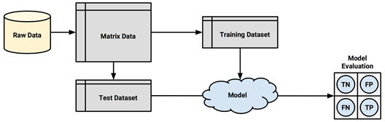
The holdout method
The procedure of partitioning data into training and test datasets that we used in previous chapters is known as the holdout method.
As shown in the diagram, the training dataset is used to generate the model, which is then applied to the test dataset to generate predictions for evaluation.

Slide 39
The holdout method
Typically, about one-third of the data is held out for testing, and two-thirds is used for training, but this proportion can vary depending on the amount of available data.
To ensure that the training and test data do not have systematic differences, their examples are randomly divided into the two groups.
For the holdout method to result in a truly accurate estimate of the future performance, at no time should the performance on the test dataset be allowed to influence the model.

Slide 40
The holdout method
It is easy to unknowingly violate this rule by choosing the best model based upon the results of repeated testing.
For example, suppose we built several models on the training data, and selected the one with the highest accuracy on the test data.
Because we have cherry-picked the best result, the test performance is not an unbiased measure of the performance on unseen data.

Slide 41
The holdout method
To avoid this problem, it is better to divide the original data so that in addition to the training datasets and the test datasets, a validation dataset is available.
The validation dataset would be used for iterating and refining the model or models chosen, leaving the test dataset to be used only once as a final step to report an estimated error rate for future predictions.
A typical split between training, test, and validation would be 50 percent, 25 percent, and 25 percent, respectively.

Slide 42
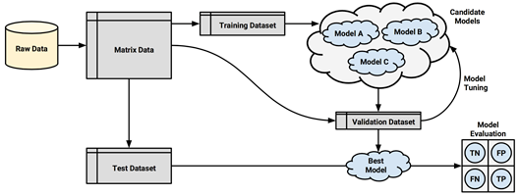
The holdout method
A simple method to create holdout samples uses random number generators to assign records to partitions.

Slide 43
The holdout method
In order to reduce the chance of this occurring, a technique called stratified random sampling can be used.
Although in the long run a random sample should contain roughly the same proportion of each class value as the full dataset, stratified random sampling guarantees that the random partitions have nearly the same proportion of each class as the full dataset, even when some classes are small.

Slide 44
The holdout method
A technique called repeated holdout is sometimes used to mitigate the problems of randomly composed training datasets.
The repeated holdout method is a special case of the holdout method that uses the average result from several random holdout samples to evaluate a model's performance.
As multiple holdout samples are used, it is less likely that the model is trained or tested on non representative data.

Slide 45
Cross-validation
The repeated holdout is the basis of a technique known as k-fold cross-validation (or k-fold CV), which has become the industry standard for estimating model performance.
Rather than taking repeated random samples that could potentially use the same record more than once, k-fold CV randomly divides the data into k to completely separate random partitions called folds.
Although k can be set to any number, by far, the most common convention is to use 10-fold cross-validation (10-fold CV). Why 10 folds?
The reason is that the empirical evidence suggests that there is little added benefit in using a greater number.

Slide 46
Cross-validation
The reason is that the empirical evidence suggests that there is little added benefit in using a greater number.
For each of the 10 folds (each comprising 10 percent of the total data), a machine learning model is built on the remaining 90 percent of data.
The fold's matching 10 percent sample is then used for model evaluation.
After the process of training and evaluating the model has occurred for 10 times (with 10 different training/testing combinations), the average performance across all the folds is reported.

Slide 47
Cross-validation
Datasets for cross-validation can be created using the createFolds() function in the caret package.
Similar to the stratified random holdout sampling, this function will attempt to maintain the same class balance in each of the folds as in the original dataset.
The following is the command to create 10 folds:
> folds <- createFolds(credit$default, k = 10)

Slide 48
Cross-validation
The result of the createFolds() function is a list of vectors storing the row numbers
> str(folds)
List of 10
$ Fold01: int [1:100] 1 5 12 13 19 21 25 32 36 38 ...
$ Fold02: int [1:100] 16 49 78 81 84 93 105 108 128 134 ...
$ Fold03: int [1:100] 15 48 60 67 76 91 102 109 117 123 ...
$ Fold04: int [1:100] 24 28 59 64 75 85 95 97 99 104 ...
$ Fold05: int [1:100] 9 10 23 27 29 34 37 39 53 61 ...
$ Fold06: int [1:100] 4 8 41 55 58 103 118 121 144 146 ...
$ Fold07: int [1:100] 2 3 7 11 14 33 40 45 51 57 ...
$ Fold08: int [1:100] 17 30 35 52 70 107 113 129 133 137 ...
$ Fold09: int [1:100] 6 20 26 31 42 44 46 63 79 101 ...
$ Fold10: int [1:100] 18 22 43 50 68 77 80 88 106 111 ...

Slide 49
Cross-validation
The first fold is named Fold01 and stores 100 integers, indicating the 100 rows in the credit data frame for the first fold.
To create training and test datasets to build and evaluate a model, an additional step is needed.
To create data for the first fold. We'll assign the selected 10 percent to the test dataset, and use the negative symbol to assign the remaining 90 percent to the training dataset:
> credit01_test <- credit[folds$Fold01, ]
> credit01_train <- credit[-folds$Fold01, ]

Slide 50
Cross-validation
To perform the full 10-fold CV, this step would need to be repeated a total of 10 times; building a model and then calculating the model's performance each time.
At the end, the performance measures would be averaged to obtain the overall performance.
We can automate this task by applying several of the techniques we've learned earlier.
To demonstrate the process, we'll estimate the kappa statistic for a C5.0 decision tree model of the credit data using 10-fold CV.

Slide 51
Cross-validation
First, we need to load some R packages: caret (to create the folds), C50 (for the decision tree), and irr (to calculate kappa).
> library(caret)
> library(C50)
> library(irr)
Next, we'll create a list of 10 folds as we have done previously. The set.seed() function is used here to ensure that the results are consistent if the same code is run again:
> set.seed(123)
> folds <- createFolds(credit$default, k = 10)

Slide 52
Cross-validation
Finally, we will apply a series of identical steps to the list of folds using the lapply() function.
Our custom function divides the credit data frame into training and test data, builds a decision tree using the C5.0() function on the training data, generates a set of predictions from the test data, and compares the predicted and actual values using the kappa2() function:
> cv_results <- lapply(folds, function(x) {
credit_train <- credit[-x, ]
credit_test <- credit[x, ]
credit_model <- C5.0(default ~ ., data = credit_train)
credit_pred <- predict(credit_model, credit_test)
credit_actual <- credit_test$default
kappa <- kappa2(data.frame(credit_actual, credit_pred))$value
return(kappa)
})

Slide 53
Cross-validation
The resulting kappa statistics are compiled into a list stored in the cv_results object, which we can examine using str():
> str(cv_results)
List of 10
$ Fold01: num 0.343
$ Fold02: num 0.255
$ Fold03: num 0.109
$ Fold04: num 0.107
$ Fold05: num 0.338
$ Fold06: num 0.474
$ Fold07: num 0.245
$ Fold08: num 0.0365
$ Fold09: num 0.425
$ Fold10: num 0.505

Slide 54
Cross-validation
There's just one more step remaining in the 10-fold CV process: we must calculate the average of these 10 values.
Although you will be tempted to type mean(cv_results), because cv_results is not a numeric vector, the result would be an error.
Instead, use the unlist() function, which eliminates the list structure, and reduces cv_results to a numeric vector. From here, we can calculate the mean kappa as expected:
> mean(unlist(cv_results))
[1] 0.283796

Slide 55
Cross-validation
This kappa statistic is fairly low, corresponding to "fair" on the interpretation scale, which suggests that the credit scoring model performs only marginally better than random chance.

Slide 56
Bootstrap sampling
A slightly less frequently used alternative to k-fold CV is known as bootstrap sampling, the bootstrap or bootstrapping for short.
These refer to the statistical methods of using random samples of data to estimate the properties of a larger set.
When this principle is applied to machine learning model performance, it implies the creation of several randomly selected training and test datasets, which are then used to estimate performance statistics.
The results from the various random datasets are then averaged to obtain a final estimate of future performance.

Slide 57
Bootstrap sampling
So, what makes this procedure different from k-fold CV?
Whereas cross-validation divides the data into separate partitions in which each example can appear only once, the bootstrap allows examples to be selected multiple times through a process of sampling with replacement.
This means that from the original dataset of n examples, the bootstrap procedure will create one or more new training datasets that will also contain n examples, some of which are repeated.
The corresponding test datasets are then constructed from the set of examples that were not selected for the respective training datasets.

Slide 58
Bootstrap sampling
Using sampling with replacement as described previously, the probability that any given instance is included in the training dataset is 63.2 percent.
Consequently, the probability of any instance being in the test dataset is 36.8 percent.
In other words, the training data represents only 63.2 percent of available examples, some of which are repeated.
In contrast to 10-fold CV, which uses 90 percent of the examples for training, the bootstrap sample is less representative of the full dataset.

Slide 59
Bootstrap sampling
Because a model trained on only 63.2 percent of the training data is likely to perform worse than a model trained on a larger training set, the bootstrap's performance estimates may be substantially lower than what would be obtained when the model is later trained on the full dataset.
A special case of bootstrapping known as the 0.632 bootstrap accounts for this by calculating the final performance measure as a function of performance on both the training data (which is overly optimistic) and the test data (which is overly pessimistic).

Slide 60
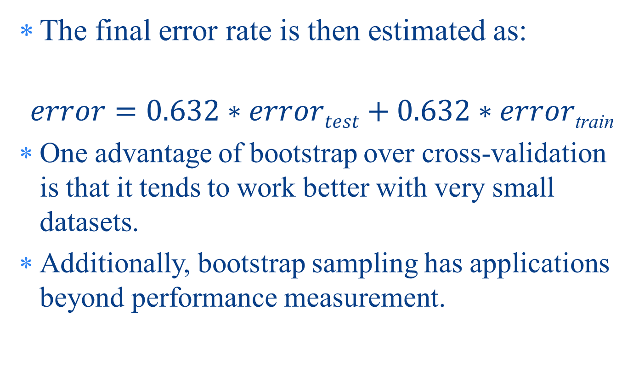
Bootstrap sampling
The final error rate is then estimated as:
$$error=0.632∗errortest+0.632∗error\text{train}$$
One advantage of bootstrap over cross-validation is that it tends to work better with very small datasets.
Additionally, bootstrap sampling has applications beyond performance measurement.

Slide 61
Improving Model Performance
How to automate model performance tuning by systematically searching for the optimal set of training conditions
The methods for combining models into groups that use teamwork to tackle tough learning tasks
How to apply a variant of decision trees, which has quickly become popular due to its impressive performance

Slide 62
Understanding ensembles
The ensemble methods are based on the idea that by combining multiple weaker learners, a stronger learner is created.
The various ensemble methods can be distinguished, in large part, by the answers to these two questions:
How are the weak learning models chosen and/or constructed?
How are the weak learners' predictions combined to make a single final prediction?

Slide 63
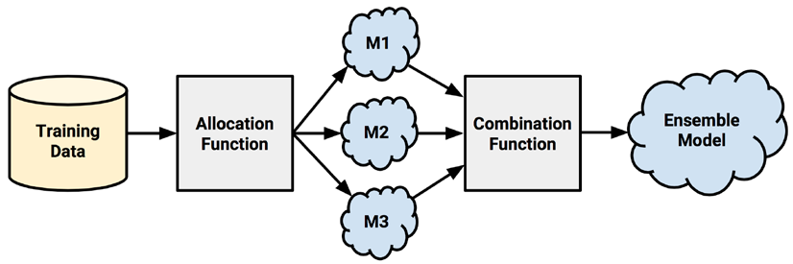
Understanding ensembles
First, input training data is used to build a number of models.
The allocation function dictates how much of the training data each model receives.
Whether they each receive the full training dataset or merely a sample.
Whether they each receive every feature or a subset.

Slide 64
Understanding ensembles
the ideal ensemble includes a diverse set of models, the allocation function can increase diversity by artificially varying the input data to bias the resulting learners, even if they are the same type.
For instance, it might use bootstrap sampling to construct unique training datasets or pass on a different subset of features or examples to each model. On the other hand, if the ensemble already includes a diverse set of algorithms—such as a neural network, a decision tree, and a k-NN classifier—the allocation function might pass the data on to each algorithm relatively unchanged.

Slide 65
Understanding ensembles
After the models are constructed, they can be used to generate a set of predictions, which must be managed in some way.
The combination function governs how disagreements among the predictions are reconciled.
For example, the ensemble might use a majority vote to determine the final prediction, or it could use a more complex strategy such as weighting each model's votes based on its prior performance.

Slide 66
Understanding ensembles
Some ensembles even utilize another model to learn a combination function from various combinations of predictions.
For example, suppose that when M1 and M2 both vote yes, the actual class value is usually no. In this case, the ensemble could learn to ignore the vote of M1 and M2 when they agree.
This process of using the predictions of several models to train a final arbiter model is known as stacking.

Slide 67
Understanding ensembles
One of the benefits of using ensembles is that they may allow you to spend less time in pursuit of a single best model. Instead, you can train a number of reasonably strong candidates and combine them.
Ensembles also offer a number of performance advantages over single models:
Better generalizability to future problems: As the opinions of several learners are incorporated into a single final prediction, no single bias is able to dominate. This reduces the chance of over fitting to a learning task.

Slide 68
Understanding ensembles
Improved performance on massive or miniscule datasets:
Many models run into memory or complexity limits when an extremely large set of features or examples are used,
making it more efficient to train several small models than a single full model..
Conversely, ensembles also do well on the smallest datasets because resampling methods such as bootstrapping are inherently a part of many ensemble designs.
Perhaps most importantly, it is often possible to train an ensemble in parallel using distributed computing methods.

Slide 69
Understanding ensembles
The ability to synthesize data from distinct domains: Since there is no onesize-fits-all learning algorithm, the ensemble's ability to incorporate evidence from multiple types of learners is increasingly important as complex phenomena rely on data drawn from diverse domains.
A more nuanced understanding of difficult learning tasks: Real-world phenomena are often extremely complex with many interacting intricacies. Models that divide the task into smaller portions are likely to more accurately capture subtle patterns that a single global model might miss.

Slide 70
Bagging
One of the first ensemble methods used a technique called bootstrap aggregating or bagging for short.
Bagging generates a number of training datasets by bootstrap sampling the original training data.
These datasets are then used to generate a set of models using a single learning algorithm. The models' predictions are combined using voting (for classification) or averaging (for numeric prediction).

Slide 71
Bagging
Bagging is a relatively simple ensemble, it can perform quite with relatively unstable learners,
that is, those generating models that tend to change substantially when the input data changes only slightly.
Unstable models are essential in order to ensure the ensemble's diversity in spite of only minor variations between the bootstrap training datasets.
Bagging is often used with decision trees, which have the tendency to vary dramatically given minor changes in the input data.

Slide 72
Bagging
The 1pred package offers a classic implementation of bagged decision trees.
The nbagg parameter is used to control the number of decision trees voting in the ensemble (with a default value of 25).
Depending on the difficulty of the learning task and the amount of training data, increasing this number may improve the model's performance up to a limit.
But additional computational expense because a large number of trees may take some time to train.

Slide 73
Boosting
Another common ensemble-based method is called boosting because it boosts the performance of weak learners to attain the performance of stronger learners.
This method is based largely on the work of Robert Schapire and Yoav Freund, who have published extensively on the topic.
Similar to bagging, boosting uses ensembles of models trained on resampled data and a vote to determine the final prediction.
There are two key distinctions.
First, the resampled datasets in boosting are constructed specifically to generate complementary learners.
Second, rather than giving each learner an equal vote, boosting gives each learner's vote a weight based on its past performance.
Models that perform better have greater influence over the ensemble's final prediction.

Slide 74
Boosting
Boosting will result in performance that is often quite better and certainly no worse than the best of the models in the ensemble.
Since the models in the ensemble are built to be complementary, it is possible to increase ensemble performance to an arbitrary threshold simply by adding additional classifiers to the group, assuming that each classifier performs better.
Boosting is thought to be one of the most significant discoveries in machine learning.

Slide 75
Boosting
A boosting algorithm called AdaBoost or adaptive boosting was proposed by Freund and Schapire in 1997.
Though boosting principles can be applied to nearly any type of model, the principles are most commonly used with decision trees.
The algorithm is based on the idea of generating weak learners that iteratively learn a larger portion of the difficult-to-classify examples by paying more attention (that is, giving more weight) to frequently misclassified examples.
Beginning from an unweighted dataset, the first classifier attempts to model the outcome.

Slide 76
Boosting
Examples that the classifier predicted correctly will be less likely to appear in the training dataset for the following classifier, and conversely, the difficult-to-classify examples will appear more frequently.
As additional rounds of weak learners are added, they are trained on data with successively more difficult examples.
The process continues until the desired overall error rate is reached or performance no longer improves.
At that point, each classifier's vote is weighted according to its accuracy on the training data on which it was built.

Slide 77
Random forests
Another ensemble-based method called random forests (or decision tree forests) focuses only on ensembles of decision trees.
This method was championed by Leo Breiman and Adele Cutler, and combines the base principles of bagging with random feature selection to add additional diversity to the decision tree models.
After the ensemble of trees (the forest) is generated, the model uses a vote to combine the trees' predictions.

Slide 78
Random forests
Random forests combine versatility and power into a single machine learning approach.
As the ensemble uses only a small, random portion of the full feature set, random forests can handle extremely large datasets, where the so-called "curse of dimensionality" might cause other models to fail.
At the same time, its error rates for most learning tasks are on par with nearly any other method.

Slide 79
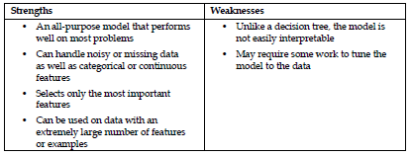
Random forests
Due to their power, versatility, and ease of use, random forests are quickly becoming one of the most popular machine learning methods.

